Slide 1
Water Quality Modeling Capabilities Todd Steissberg and Billy Johnson Water Quality and Contaminant Modeling Branch Environmental Laboratory U.S. Army Engineer Research and Development Center (ERDC) June 2, 2020

Slide 2
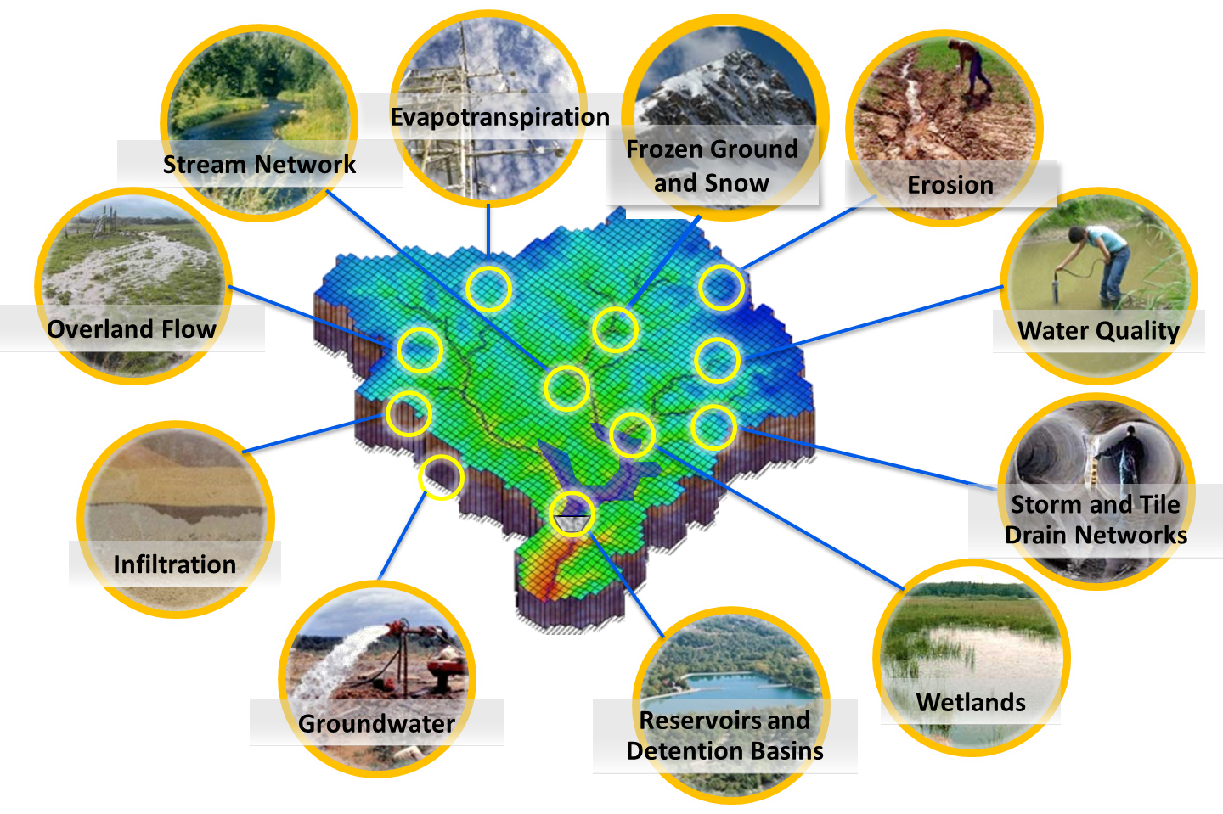
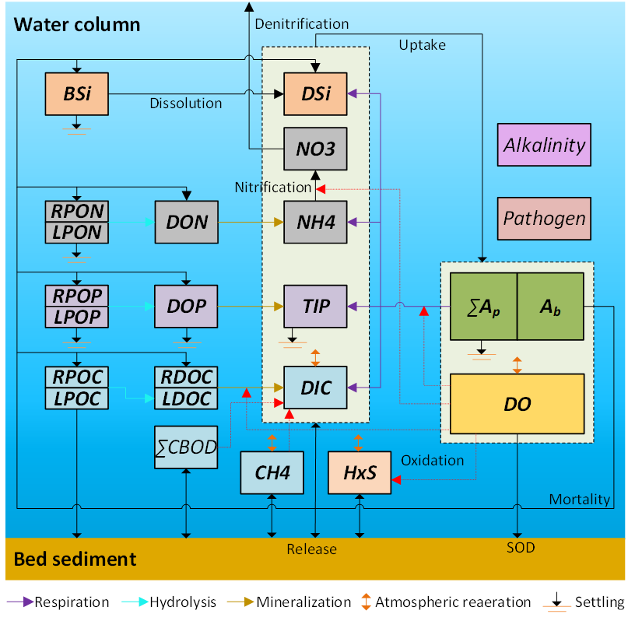
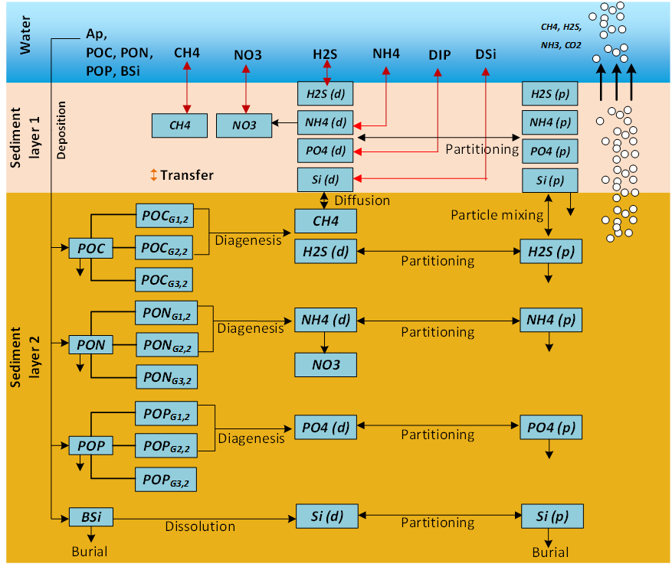
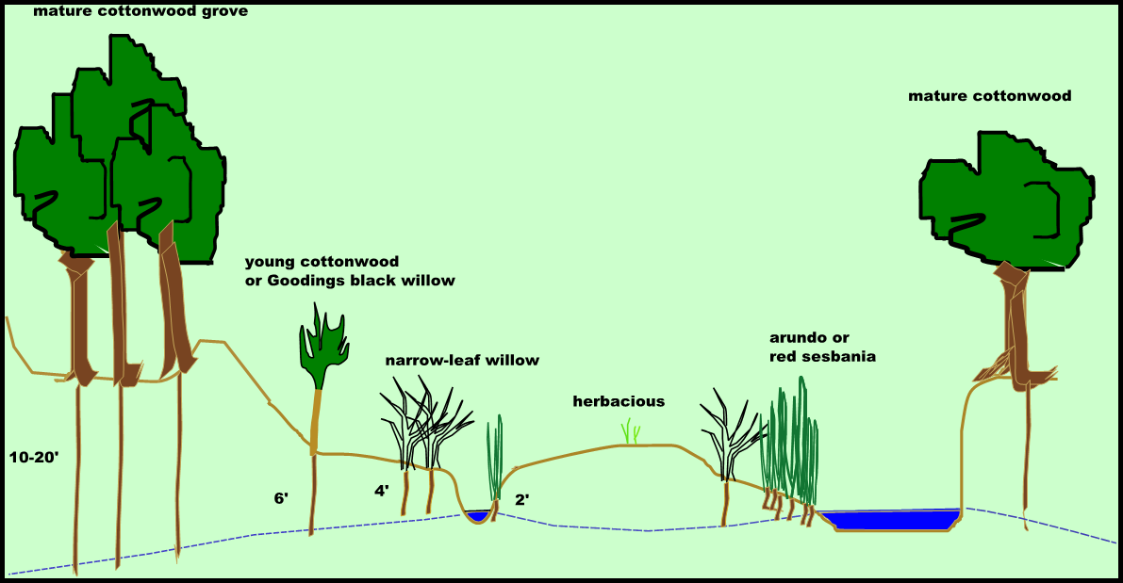
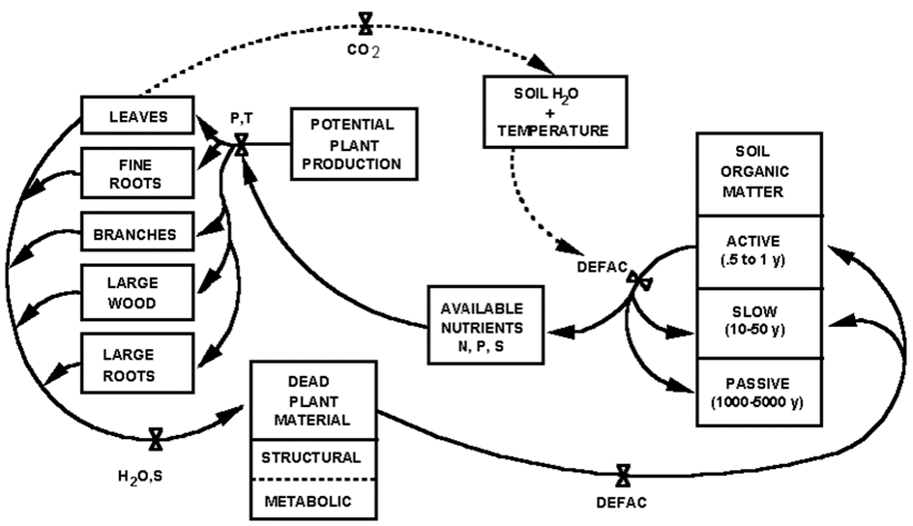
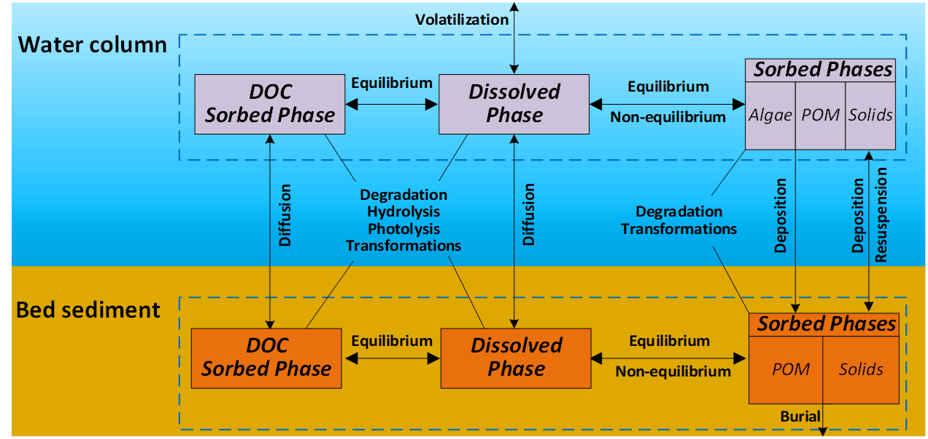
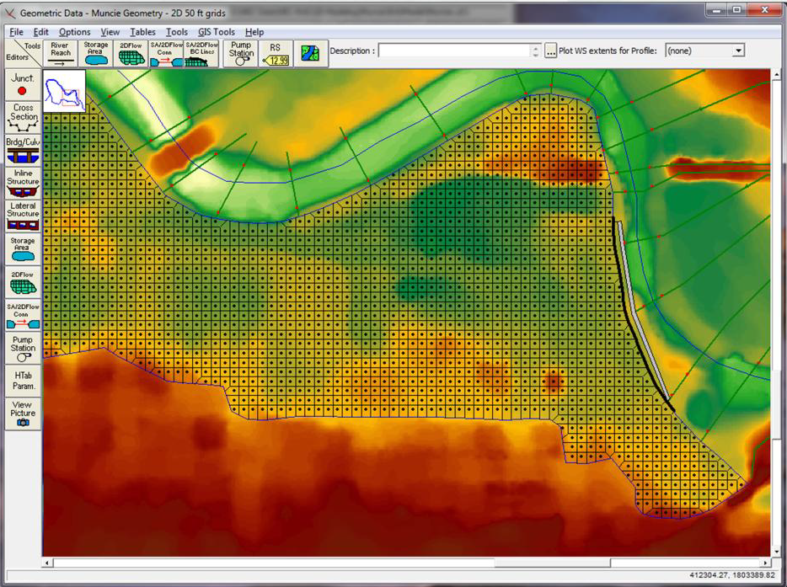
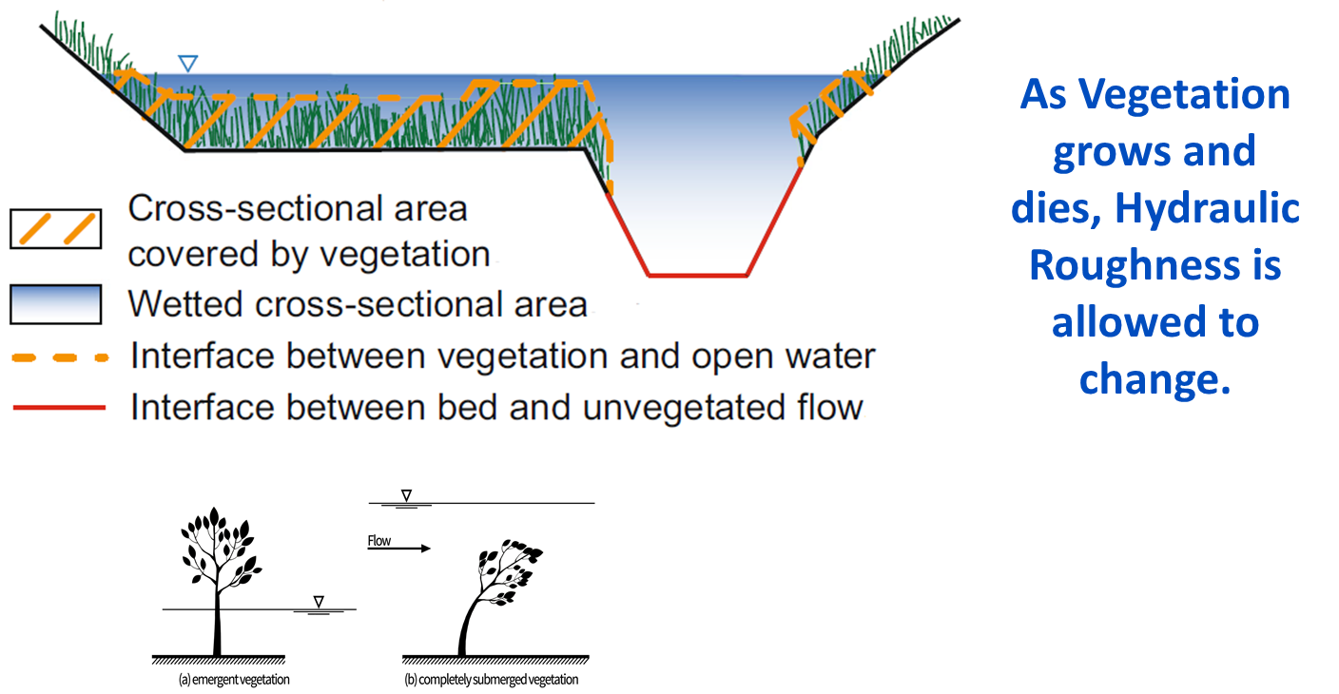
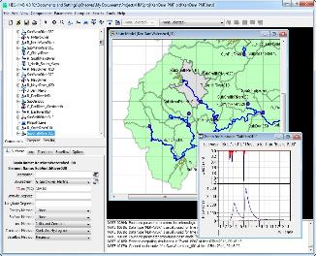
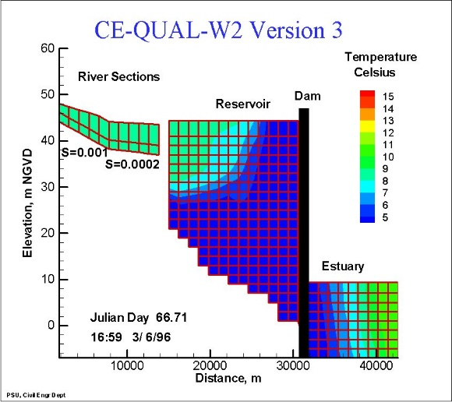
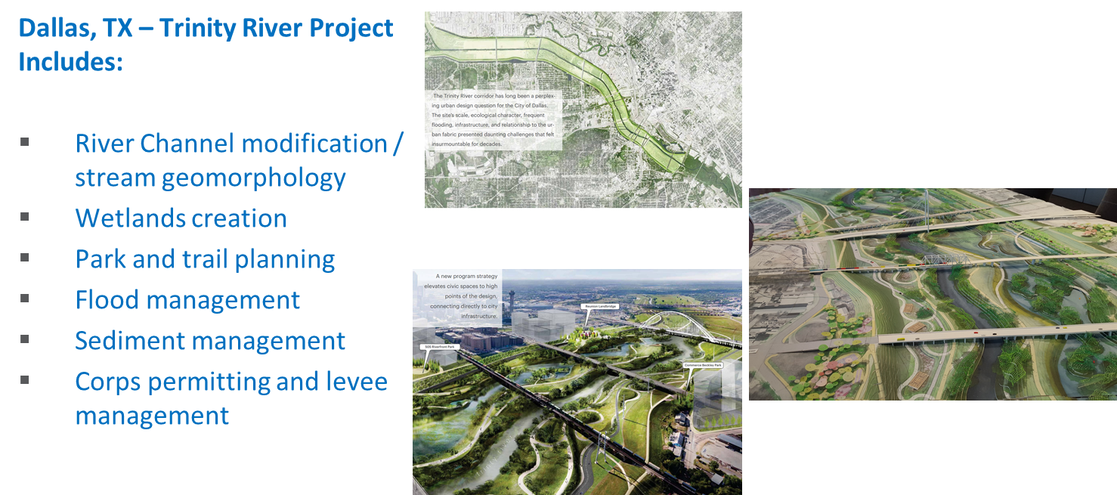
Integrated Environmental Modeling Tools
Hydraulics and Hydrology
Water Quality
Vegetation
River Section
Reservoir
Design with Natural Features
Elevation, M
Estuary
Distance, M

Slide 3
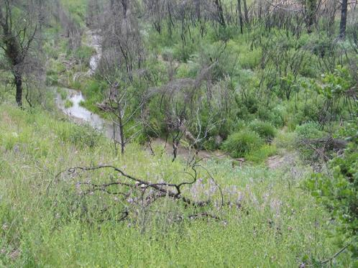
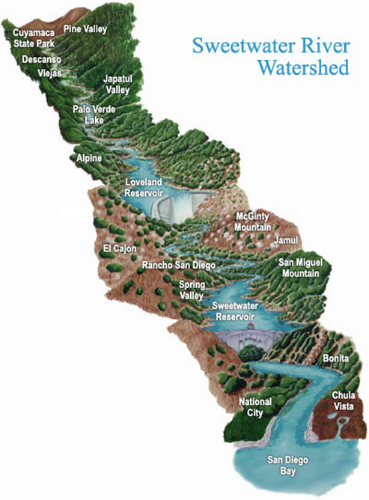
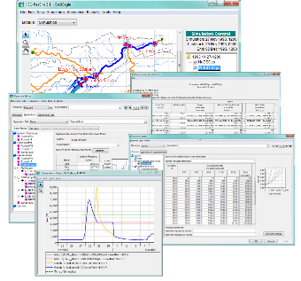
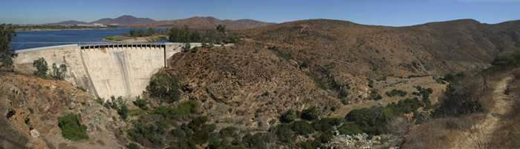
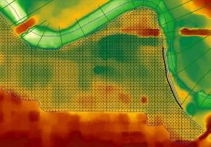
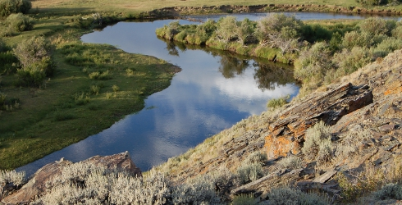
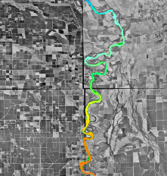
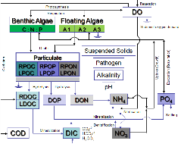
Integrated Watershed Water Quality Modeling
f
HEC-HMS
Runoff
Linked together with
CWMS (real-time)
HEC-WAT (studies)
HEC-ResSim
Reservoir release decisions
Clearwater modules and engine
CE-QUAL-W2
2D Reservoir WQ
HEC-RAS
River hydraulics

Slide 4
Water Quality and Ecological Modeling Capabilities
Clearwater (Computational Library for Environmental Analysis and Restoration of Watersheds) is a computational library that is being embedded in existing water resources simulation models.
1. Modules that simulate water temperature, chemical reactions and transformations, and riparian vegetation. These modules are:
NSM: Nutrient Simulation Module
TSM: Temperature Simulation Module
MSM: Mercury Simulation Module
CSM: Contaminant Simulation Module
SSM: Solids Simulation Module
RVSM: Riparian Vegetation Simulation Module
VSM: Vegetation Simulation Module (1D/2D riparian and aquatic vegetation)
2. A water quality engine that computes the transport processes and integrates the Clearwater modules with the water resources simulation program (e.g., HEC-ResSim)
3. Graphical User Interface (GUI) components for WQ modeling:
Controls and tables to input/import set up a WQ model
Boundary & initial conditions, variables, parameters, etc.
Plots
Reports

Slide 5
Vision: Environmental Modeling with HEC Tools
The U.S. Army Corps of Engineers’ Water Quality Modeling Team is developing next-generation water quality modeling and analysis capabilities by integrating independent water quality modules with existing water resource modeling software. The team consists of staff from ERDC, HEC, USACE Districts, and other organizations. An ERDC-HEC partnership was established to develop water quality modeling capabilities for three widely used water resources modeling programs developed by the Hydrologic Engineering Center. These are:
HEC-ResSim (Reservoir System Simulation): simulates reservoir operations for one or more reservoirs for flood management, planning studies, real-time decision support, and many other purposes.
HEC-RAS (River Analysis System): simulates river hydraulics, computing water levels and velocities, and generates inundation (flood) maps
HEC-HMS (Hydrologic Modeling System): simulates runoff from the watershed
HEC models have been built for most of the watersheds in the U.S. and for many of the watersheds in other countries. The water quality capabilities being developed for the HEC software leverages these models and existing software capabilities distribute advanced water quality modeling capabilities around the world. These will be linked, leveraging the strengths of each model to perform integrated watershed-scale water quality modeling for ecosystem assessment, restoration, and management.

Slide 6
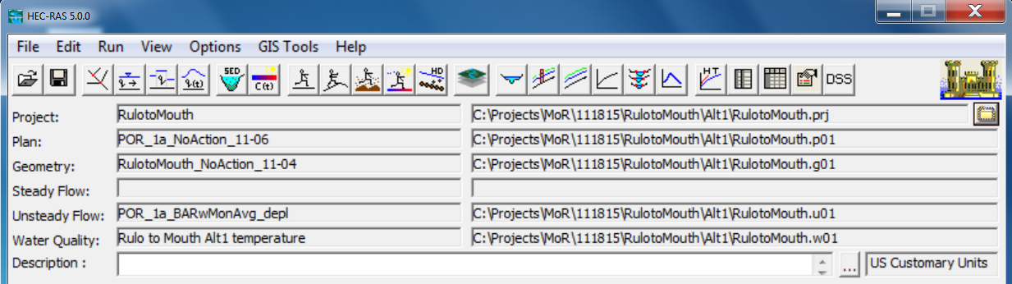
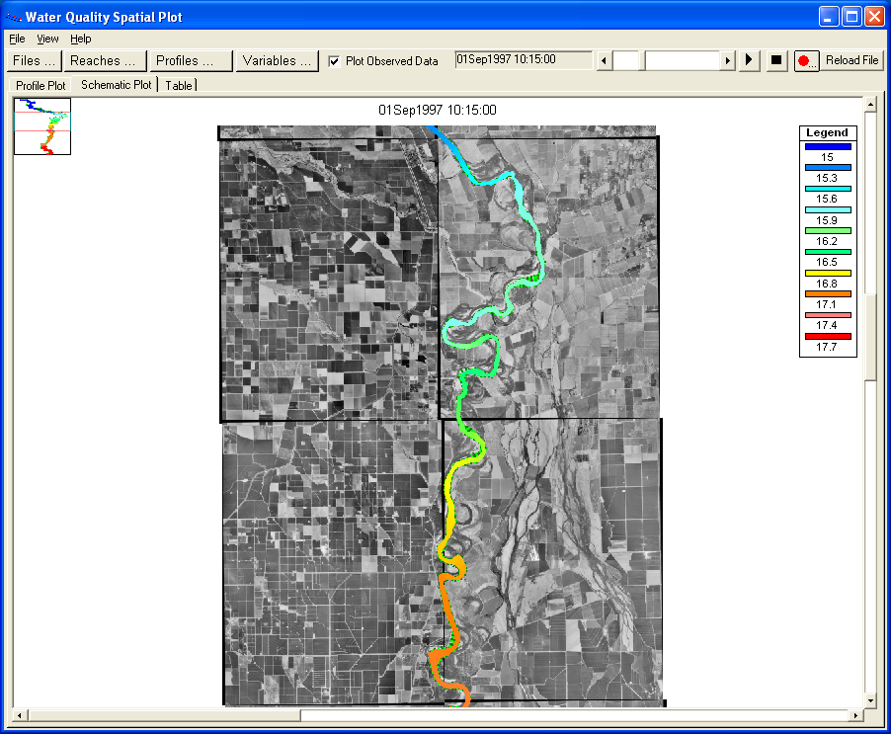
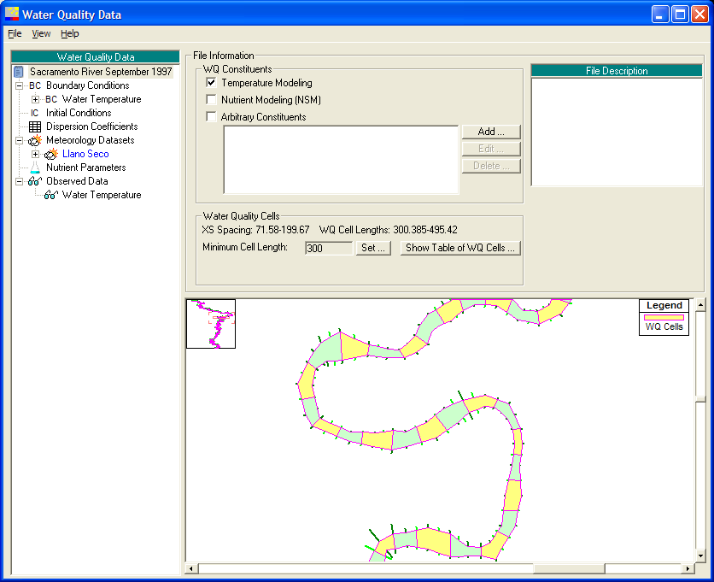
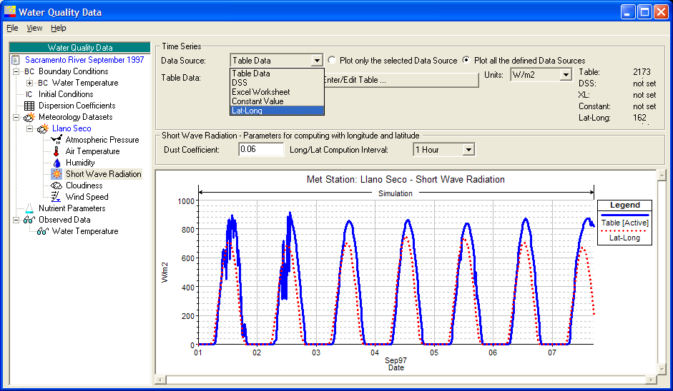
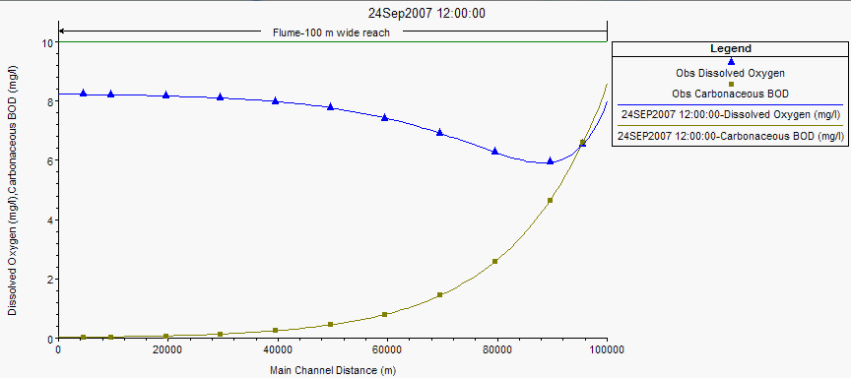
HEC-RAS River Water Quality (1D)
HEC-RAS (River Analysis System) simulates 1D and 2D river hydraulics
Computes river velocities, stages, profiles, and inundated areas (with RAS Mapper) given stream flow and geometry
Industry standard hydraulic tool used worldwide
100,000 worldwide downloads/year
One-dimensional (1D) water quality capabilities allow environmental impacts assessments in rivers and streams

Slide 7
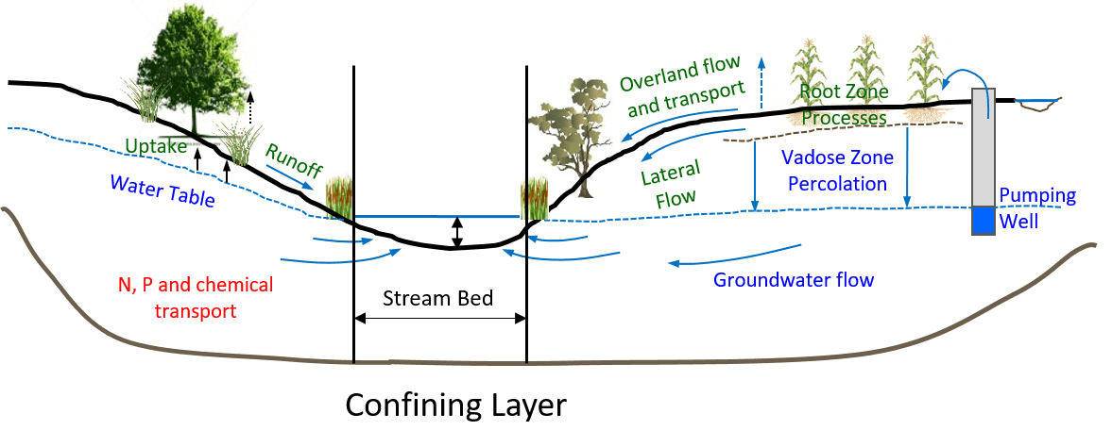
Riparian Vegetation Simulation Module (RVSM)
The Riparian Vegetation Simulation Module (RVSM) simulates the lifecycle of vegetation, including seed dispersal, seedling establishment, and plant growth and mortality in response to dynamic physical conditions.
RVSM includes eleven vegetation roughness computation methods.
Hydrologic Processes:

Slide 8
HEC-RAS Riparian Vegetation Simulation
RVSM was integrated into HEC-RAS to simulate the interactions between flow and riparian vegetation on floodplains.
RVSM can help answer the following questions:
What impact does riparian vegetation have on local flood conditions?
What set of riverine operations can be used to encourage recruitment and survival of native vegetation (and control the spread of invasive species)?
What impact will management actions have on habitat for endangered and threatened species?
For each time step:
HEC-RAS computes water surface elevation, discharge, average velocity, energy slope of each cross section.
RVSM simulates the impacts of these variables on the riparian vegetation lifecycle and computes the impacts of riparian vegetation on channel roughness (Manning’s n values).
The new roughness values replace the previous values in the HEC-RAS model and are used to compute new hydraulic variables for the next time step.

Slide 9
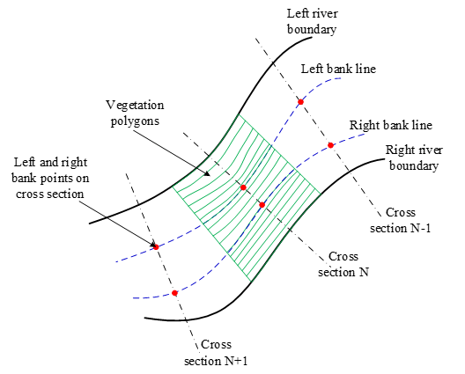
HEC-RAS Riparian Vegetation Simulation
Application:
The riparian zone needs to be discretized into a vegetation computation mesh, including an array of parallel slice polygons along the channel bank.
HEC-RAS schematic with vegetation polygons:

Slide 10
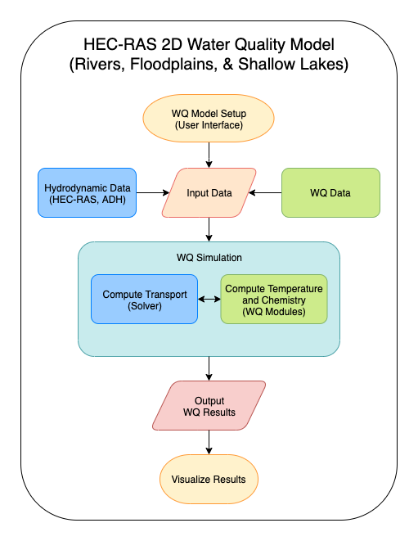
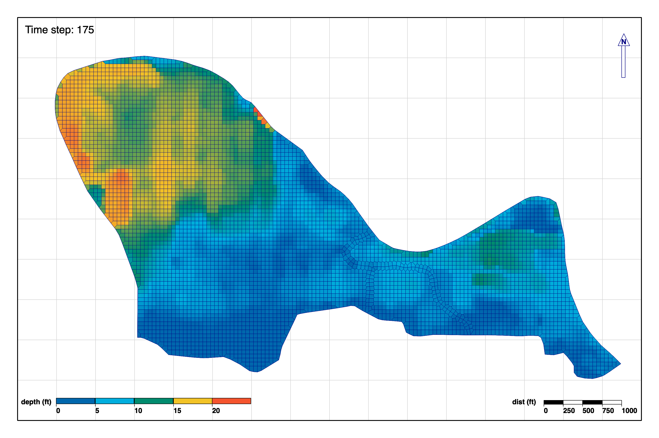
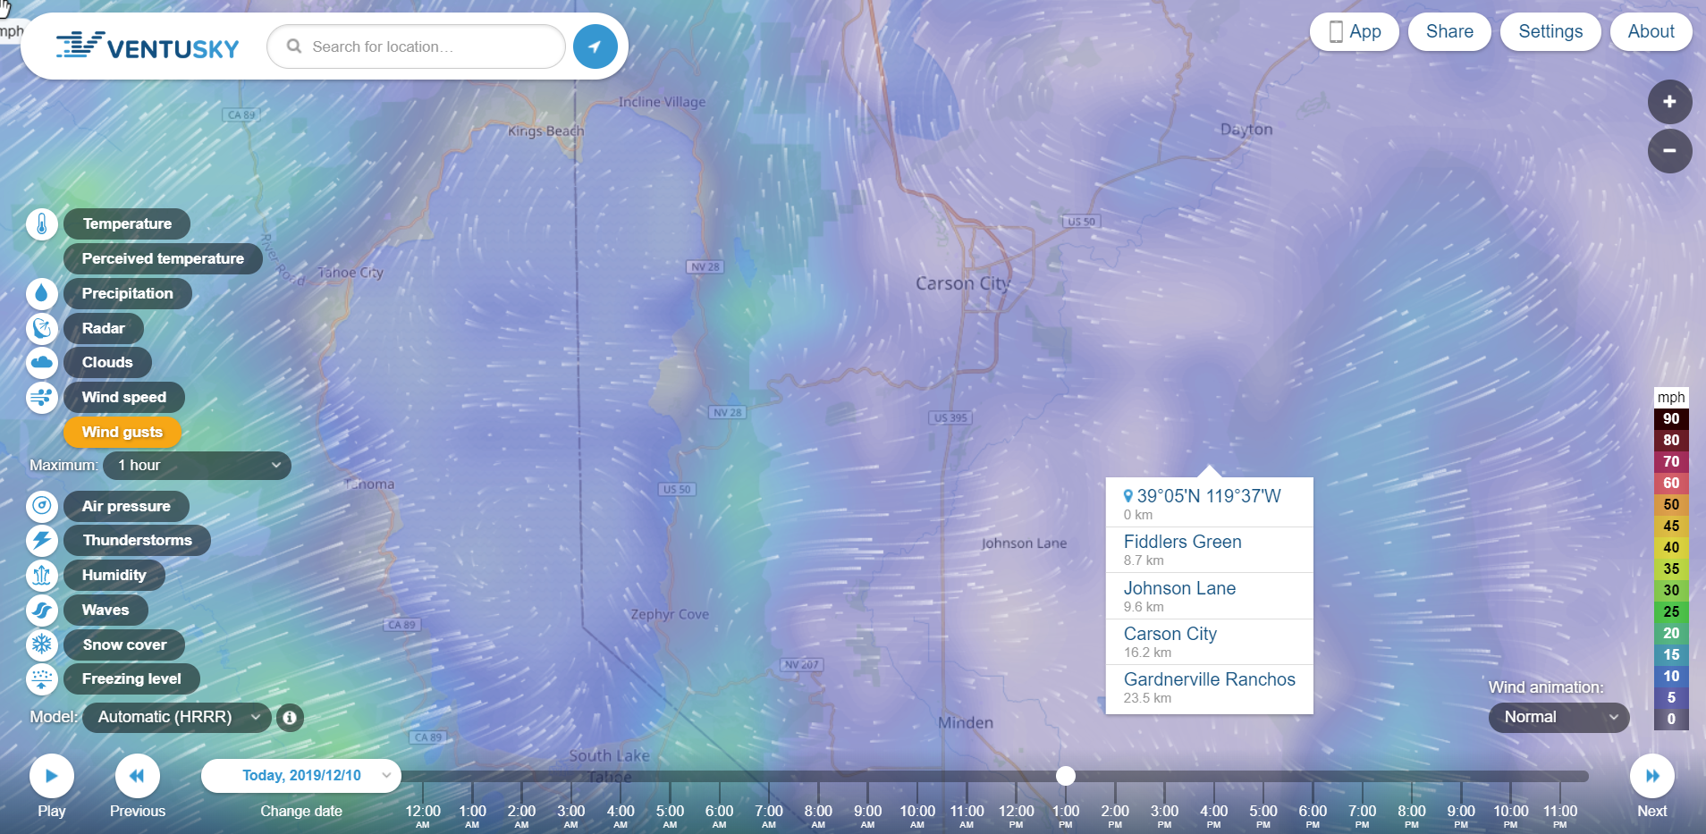
HEC-RAS - 2D Water Quality Two-Dimensional (2D) Depth-Averaged Water Quality

Slide 11
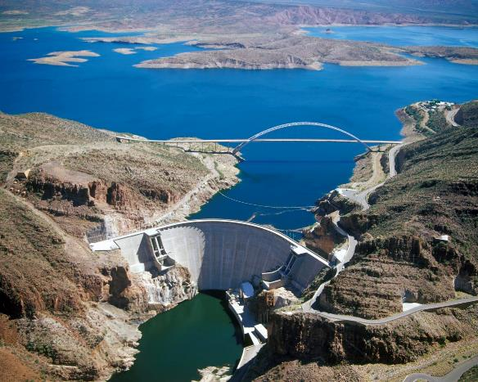
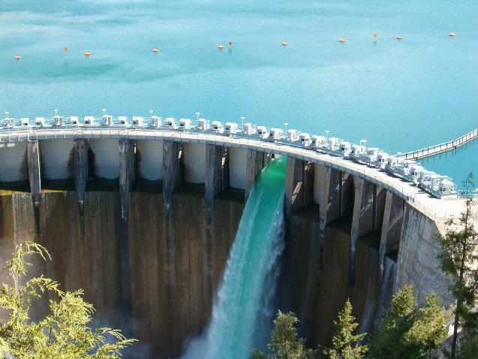

HEC-ResSim Water Quality
Flows influence water quality
Water quality must influence flows
Problem: Currently, water quality modeling is performed separately from reservoir operation decision-making, with results being laboriously transferred between models, which have to be repeatedly adjusted and recomputed to achieve environmental project objectives. Environmental considerations are not directly accounted for in reservoir operations decision-making, since existing reservoir water quality models cannot continuously inform reservoir operations models about how much water should be released meet these requirements.
Purpose: Integrate water quality modeling capabilities into HEC-ResSim so that water quality and related environmental objectives can directly influence reservoir release decision-making as well as providing capabilities for watershed-scale ecosystem assessment and management.
Notes:
We currently lack reservoir operations simulation software with the capability to fully integrate environmental objectives into reservoir release decision-making
Water quantity and quality simulations are performed independently and sequentially in a one-way process
Water quantity influences the water quality models
However, water quality does not directly influence the computed releases. Influence and iteration is at the discretion of the modeler
This severely inhibits the ability to identify the most effective water management alternatives for meeting multiple objectives
WQ information is needed at every time step
EMRRP (Ecosystem Management and Restoration Research Program)
Approved by ERARG (Environmental Research Area Review Group

Slide 12
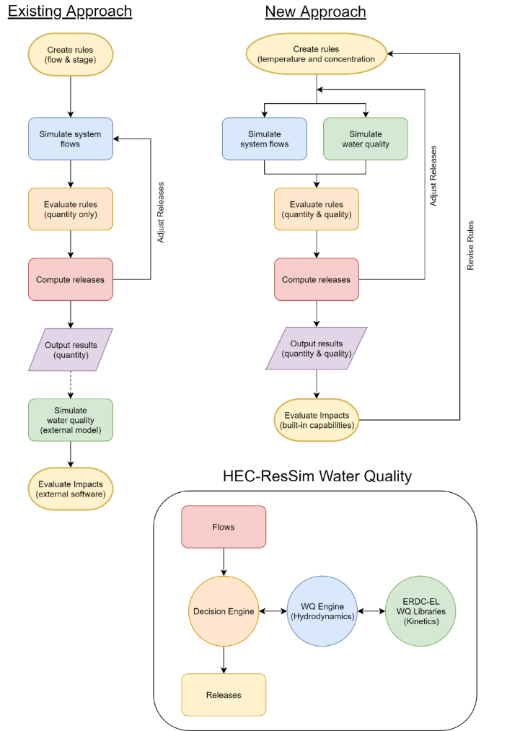
HEC-ResSim Water Quality
Existing Approach
WQ is simulated with an external model (e.g., HEC-5Q) after the HEC-ResSim flow simulation is complete.
Rules are specified in terms of stage or flow.
Environmental objectives are often lumped with other objectives, like navigation, flood control, or hydropower.
If the desired environmental benefits of an alternative are not achieved, new guesses need to be made, and the simulation recomputed. This stage is often skipped altogether.
New Approach
WQ runs in parallel with the system hydrology and release decisions
Reservoir operation rules can be specified directly (i.e., temperature, concentration, or load) to meet environmental objectives
Project teams will have the opportunity to define rules for environmental objectives independent of other objectives,
(Manually)

Slide 13
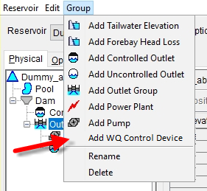
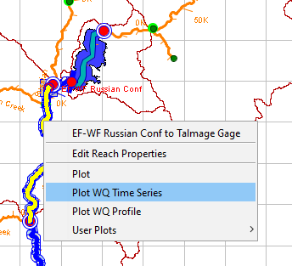
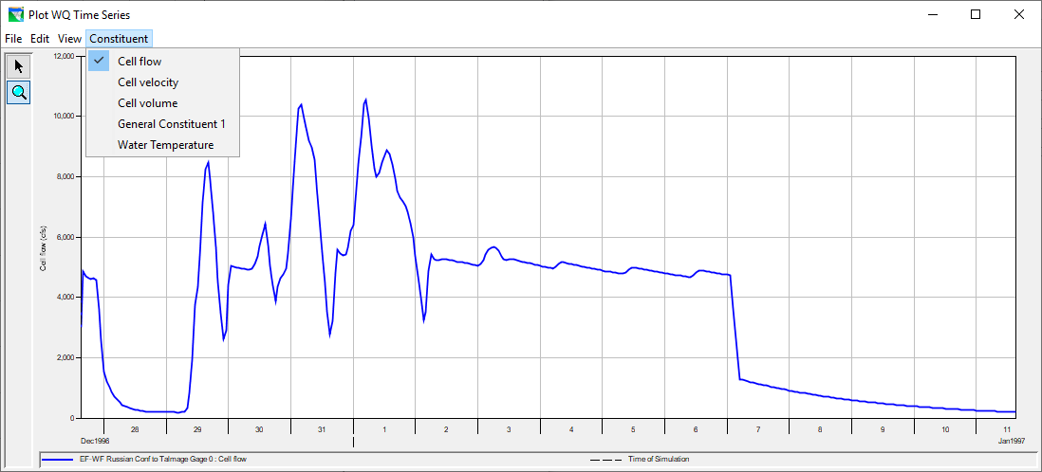
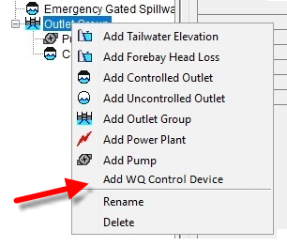
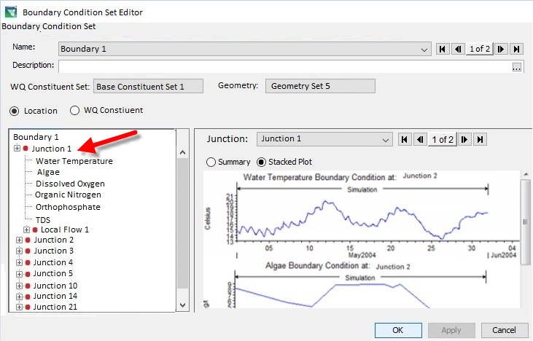
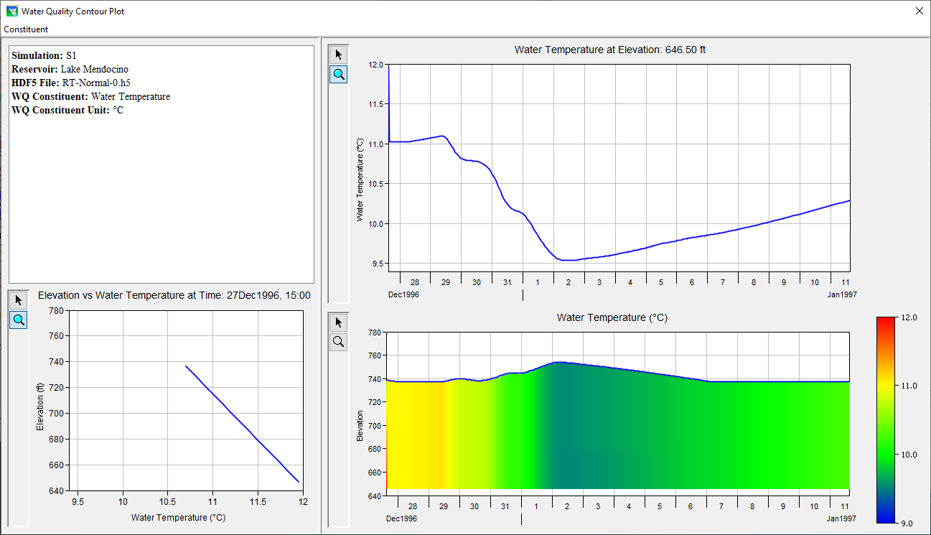
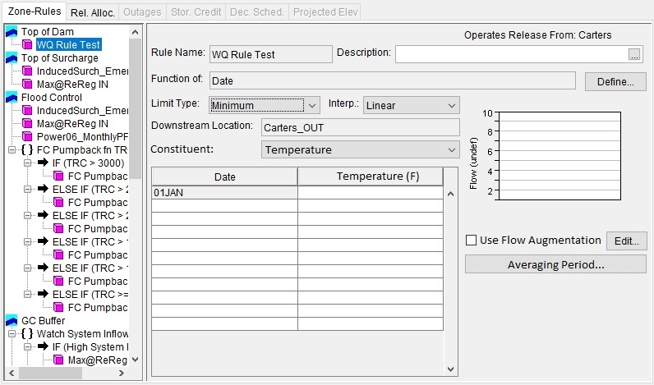
HEC-ResSim v4.0

Slide 14
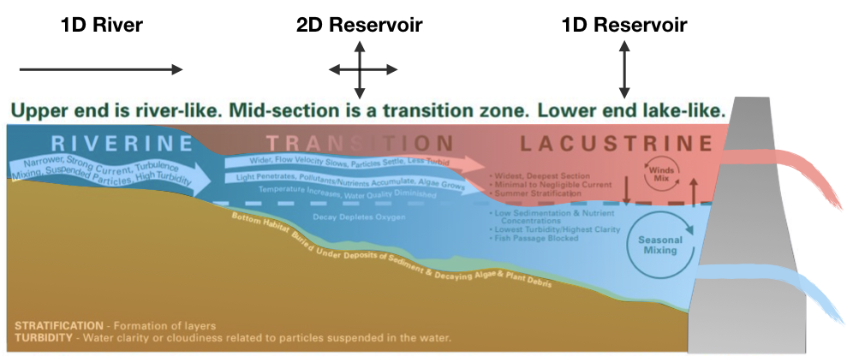
Reservoir Processes and Zones
Riverine zone
River-like flows within channel
Minimum requirement: 1D river model (segments)
Lacustrine zone
Lake-like system, vertically stratified, slow flows
Minimum requirement: 1D reservoir model (layers)
Transition zone
Stratification and downstream flows important
Minimum requirement: 2D model (layers and segments)
Reservoir system with important flow, WQ, and ecosystem processes for each of three zones.
Notes:
1D river model for channels in a reservoir system
2D river model for floodplain simulation

Slide 15
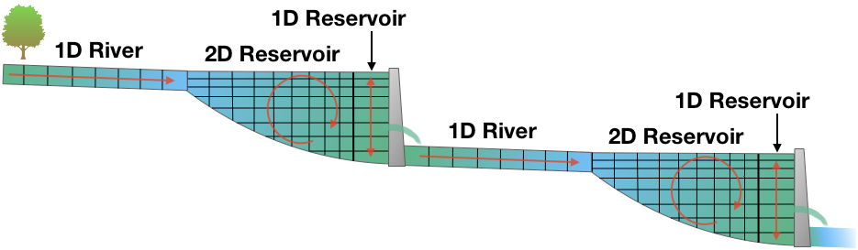
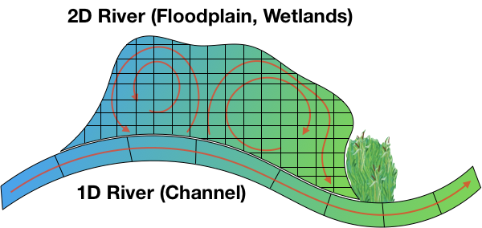
Reservoir and River WQ Model Dimensions
River-Reservoir System (stratification important)
Unstratified reaches:
Modeled as 1D rivers (segments)
Stratified reaches:
Can be modeled as 1D reservoirs (layers) for real-time release decision-making for downstream targets
Need to be modeled as 2D reservoirs (layers and segments)
Ensure accuracy, capturing important in-reservoir processes (mixing, pollutants inflows, etc.)
Identify vulnerabilities and restoration/management options (e.g., velocities and temperature for HAB management)
River-Floodplain System (unstratified)
River channels are modeled as 1D, varying from upstream to downstream
Hydrologic connectivity across the floodplain is important
2D varying across the landscape

Slide 16
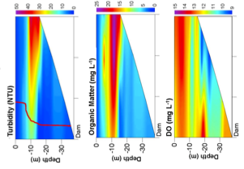
Reservoir WQ Capabilities and Modeling Gaps
Capabilities
HEC-ResSim incorporates 1D WQ in the reservoir release decision-making process
Easy to use, modern graphics and user interface
CE-QUAL-W2 simulates 2D reservoir WQ
Accurately captures in-reservoir processes
Widely used, many experienced users, many existing models
HEC-ResSim gaps:
Lacks the accuracy of higher fidelity 2D WQ reservoir models
Very limited applicability for reservoir studies
CE-QUAL-W2 gaps:
Lacks operations capabilities, user interface, visualization & analysis capabilities
Unstable for riverine reaches, limiting modeling watershed-scale reservoir systems
Lacks an official ERDC version with proper QA/QC. Cannot currently be used for planning.
Architecture and logic need to be updated to meet modern standards and computer capabilities (robust storage formats, parallel processing, etc.)
Updated WQ algorithms need to be incorporated
Very difficult to link with other models and ecosystem tools (needs improved data structures & input/output)
Difficult to set up and operate (lacks user interface, input files easy to break)
CE-QUAL-W2 WQ profiles plotted using Python and matplotlib

Slide 17
CE-QUAL-W2 V5.0 Development
Build 2D reservoir WQ modeling program capable of integrating environmental objectives into the reservoir decision-making process.
Framework: Python and Jupyter notebooks
Simulations: Fortran-based WQ engine
Implement essential operations capabilities
Leverage CE-QUAL-W2 Program
Leverage and upgrade CE-QUAL-W2’s hydrodynamics and WQ algorithms
Restructure and upgrade code, data structures, and storage formats
Improves robustness and facilitates linking with other models, ecosystem tools, etc.
Leverage ResSim WQ Program and Components
Implement modern data structures and input/output files (HDF5, DSS, GeoJSON)
Leverage code to read inflows, outflows, and WQ outputs from HEC-ResSim models
Leverage RAS 2D WQ Products
Python framework and Jupyter notebook interface with inline documentation
Storage formats for 2D data (HDF5) and parameters (JSON)
Leverage plotting capabilities/components (time series, 2D animations, etc.)
Note: Co-development of RAS 2D WQ and Reservoir 2D WQ is feasible and efficient. Components will be built that flexibly address river and reservoir modeling, visualization, and analysis needs.
RAS 2D depths and velocities. Example product for RAS 2D WQ
Reservoir temperature model, showing variability along the river/reservoir channel

Slide 18
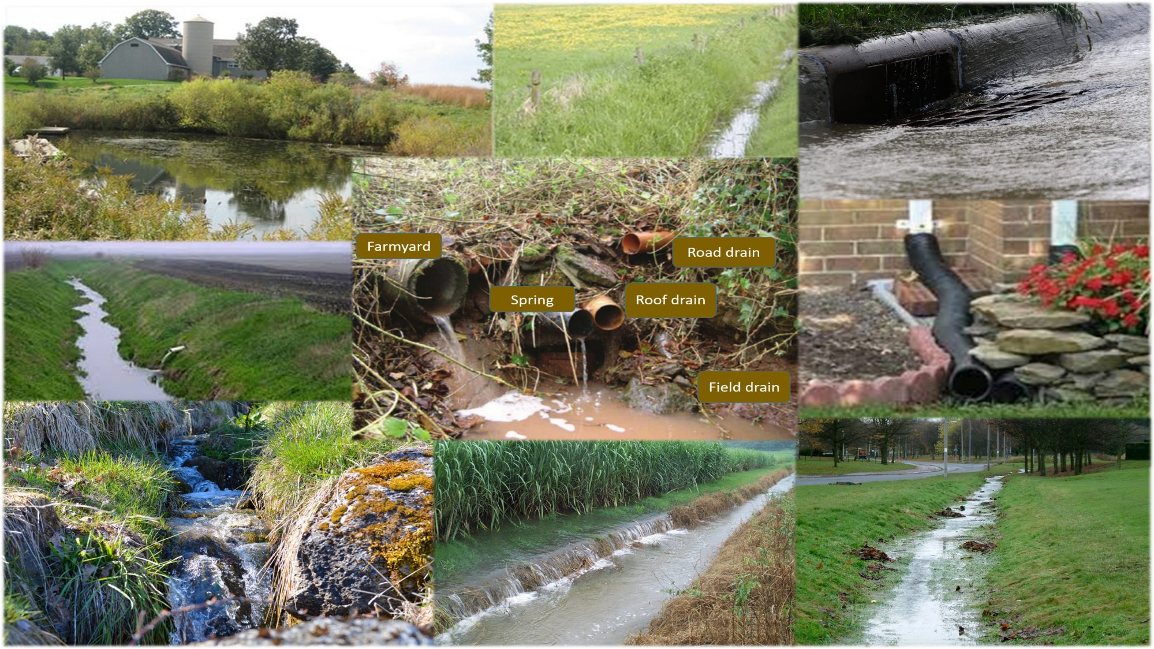
Watershed Runoff Water Quality Modeling

Slide 19
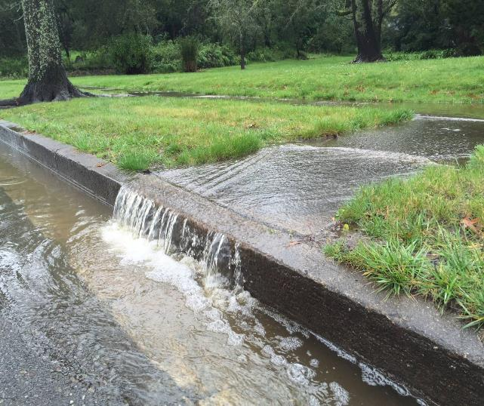
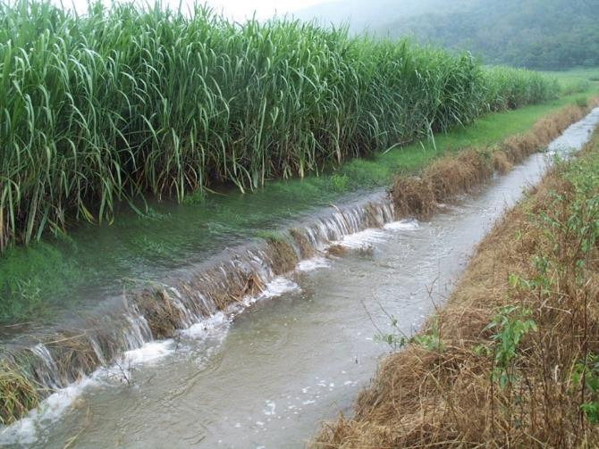
HEC-HMS Water Quality Objective
Build water quality modeling and analysis capabilities for HEC-HMS, in collaboration with ERDC Environmental Laboratory (ERDC-EL).
Implement simulation of the water temperature and user-defined general constituents for:
Overland flow
Streams
Reservoirs
This will form the foundation for a generalized next-generation watershed water quality modeling system capable of simulating non-point source water quality (nutrients, dissolved oxygen, phytoplankton, and bacteria) and characterizing its effects on the watershed.

Slide 20

Watershed Runoff Water Quality GSSHA and SWAT
Extend nutrient simulation modules (NSMs) to extend salinity capabilities
Extend contaminant simulation module (CSM) for overland flow
Link NSMs and CSM with GSSHA
Link SWAT with river and reservoir models
Build plug-ins for HEC-WAT and CWMS

Slide 21
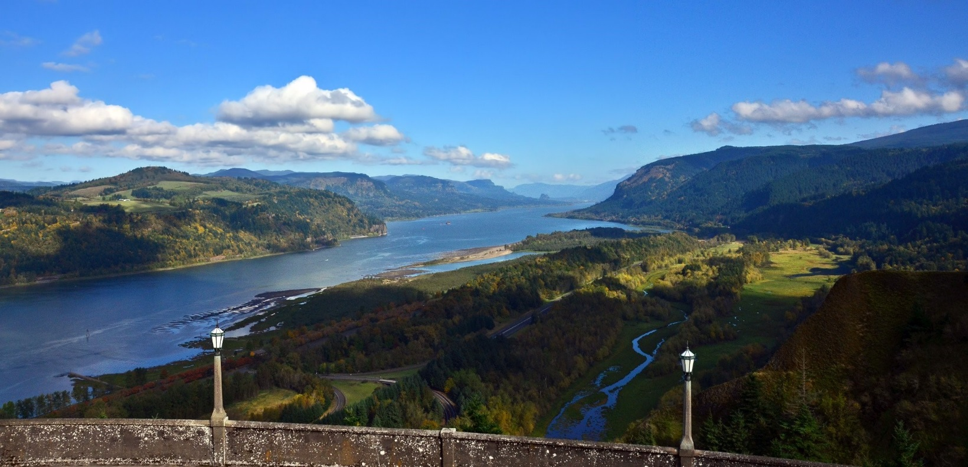
Watershed-Scale Water Quality Modeling CWMS and HEC-WAT

Slide 22
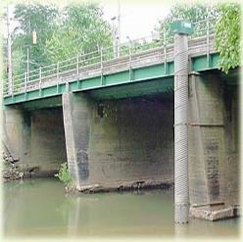
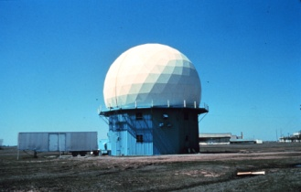
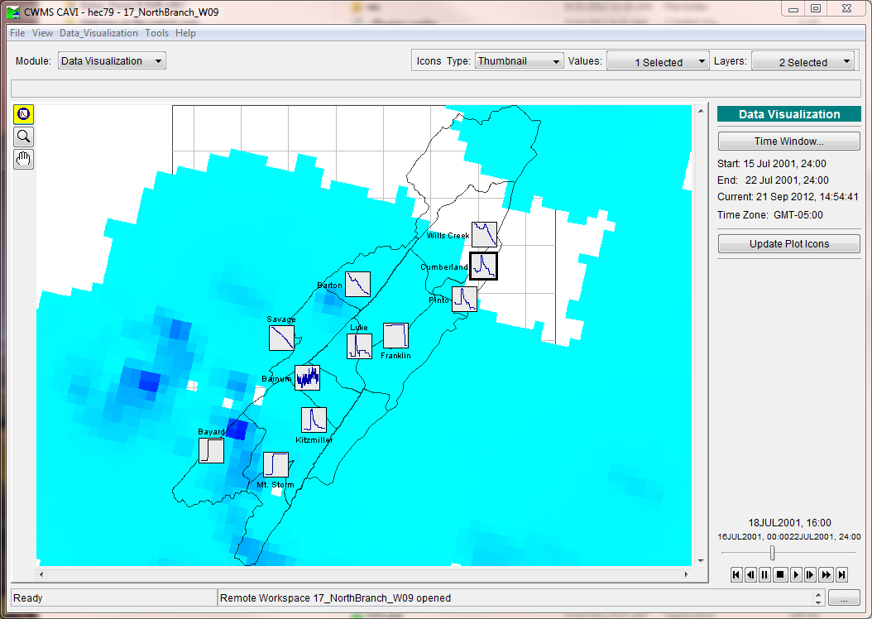




Corps Water Management System (CWMS)
CWMS (Corps Water Management System) provides real-time decision support for water management
700+ Multi-purpose reservoirs, flow control structures, levees, etc.
Features:
Real-time data acquisition
Database storage
Flow forecasting of watershed runoff
Reservoir operation decision support
River profile modeling
Inundated area determination
Consequence/damage analysis
Information dissemination
Implementation Goal: 201 CWMS systems by 2022
Water quality development in HEC-ResSim, HEC-RAS, and HEC-HMS will provide real-time water quality capabilities in CWMS
Real-Time Fully Integrated
Hydrologic Models
Streamgage
Data
NWS
Forecasts
Inundation Mapping
Operational Decisions

Slide 23






HEC-WAT (Watershed Analysis Tool)
Environmental
Hydrology
Consequences
Hydraulics
Reservoir

Slide 24



CE-QUAL-W2 Plug-In for HEC-WAT

Slide 25


USACE WQ Modeling: Watershed Systems Approach
Hydrodynamics
Nutrient Cycles
Organism Growth
Transport Solvers
Output = Temporal and/or spatial distribution of modeled constituents
HEC-RAS (1D/2D WQ)
HEC-ResSim (1D WQ)
Fully integrated riverine hydraulic, sediment, and water quality model to aid users in determining Total Maximum Daily Loads (TMDLs).
Can be linked to SWAT and HSPF
Simulates reservoir operations at one or more reservoirs to meet multiple objectives for flood control, hydropower, water supply, navigation, recreation, and environmental management.
For both planning studies and for real-time decision support.
HEC-ResSim v4.0 has fully integrated water quality (WQ) modeling capabilities for environmental impacts analysis and operational support.
Observed Data
Model Outputs

Slide 26


USACE Water Quality Modeling Tools
Several models available with varying degrees of coupling between the hydrodynamic, nutrient, organism, and transport algorithms.
Application domains range from run of river reservoirs to coastal zones.
CE-QUAL-ICM
CE-QUAL-W2
AdH-NSM-2D/3D
Fully 3D, time-variable; link to independent hydrodynamics
36 constituents
River Section
Seamlessly integrates the Nutrient Simulation Module (NSM) library.
Reservoir
Trophic interactions include submerged aquatic vegetation multiple algae groups, sediment diagenesis, benthos, and zooplankton
First model to fully couple hydrodynamics and water quality on an adaptive mesh
Includes floating and benthic algae, interrelated N, P, C, and O₂ cycles
Elevation, M
Estuary
Distance, M
2D, laterally-averaged hydrodynamic and water quality model, 28 constituents
Simulates stratified flow through variable density as affected by temperature, salinity, TDS, and TSS
Can be extended to model entire basins
Over 1600 known applications in 34 countries
Example of interdependent nutrient cycles and algae growth
Surface Chlorophyll Concentration, mg/l

Slide 27
Team Members and Collaborators (Alphabetical)
Lea Adams, USACE-HEC
Mark Ackerman, RMA
Steven Ackerman, RMA
Steve Andrews, RMA
Chris Berger, PSU
Gary Brunner, USACE-HEC
Barry Bunch, USACE-ERDC-EL
Ben Chacon, RMA
Al Cofrancesco, ERDC-EL
John DeGeorge, RMA
Pat Deliman, ERDC-EL
Mark Dortch, ERDC-EL
Chris Dunn, USACE-HEC
Paul Ely, RMA
Scott English, USACE-NWD
Trudy Estes, ERDC-EL
Matt Fleming, USACE-HEC
Alex Kennedy, USACE-HEC
Joan Klipsch, USACE-HEC
John Kucharski, USACE-HEC → ERDC
Mark Jensen, USACE-HEC
Billy Johnson, USACE-ERDC-EL
Steve Juul, USACE-NWW
Shannon Larson, RMA
Cindy Lowney, RMA
Ryan Miles, RMA
Alexis Mills, USACE-NWD
Chan Modini, USACE-HEC
Shannon Newbold, RMA
Leila Ostadrahimi, USACE-HEC
Jay Pak, USACE-HEC
Steve Piper, RMA
Kervi Ramos, HEC/Apple → ERDC
Jodi Ryder, USACE-ERDC-EL
Alex Sanchez, USACE-HEC
Bill Scharffenberg, USACE-HEC
Don Smith, RMA
Todd Steissberg, USACE-ERDC-EL
Julia Slaughter, USACE-HEC
Kathryn Tackley, USACE-NWP
Tammy Threadgill, USACE-ERDC-EL
Dottie Tillman, USACE-ERDC-EL
Dan Turner, USACE-NWD
Scott Wells, PSU
Brian Zettle, USACE-SAM
Zhonglong Zhang, PSU/LimnoTech

Slide 28
Thank You Questions?

